Slide 1
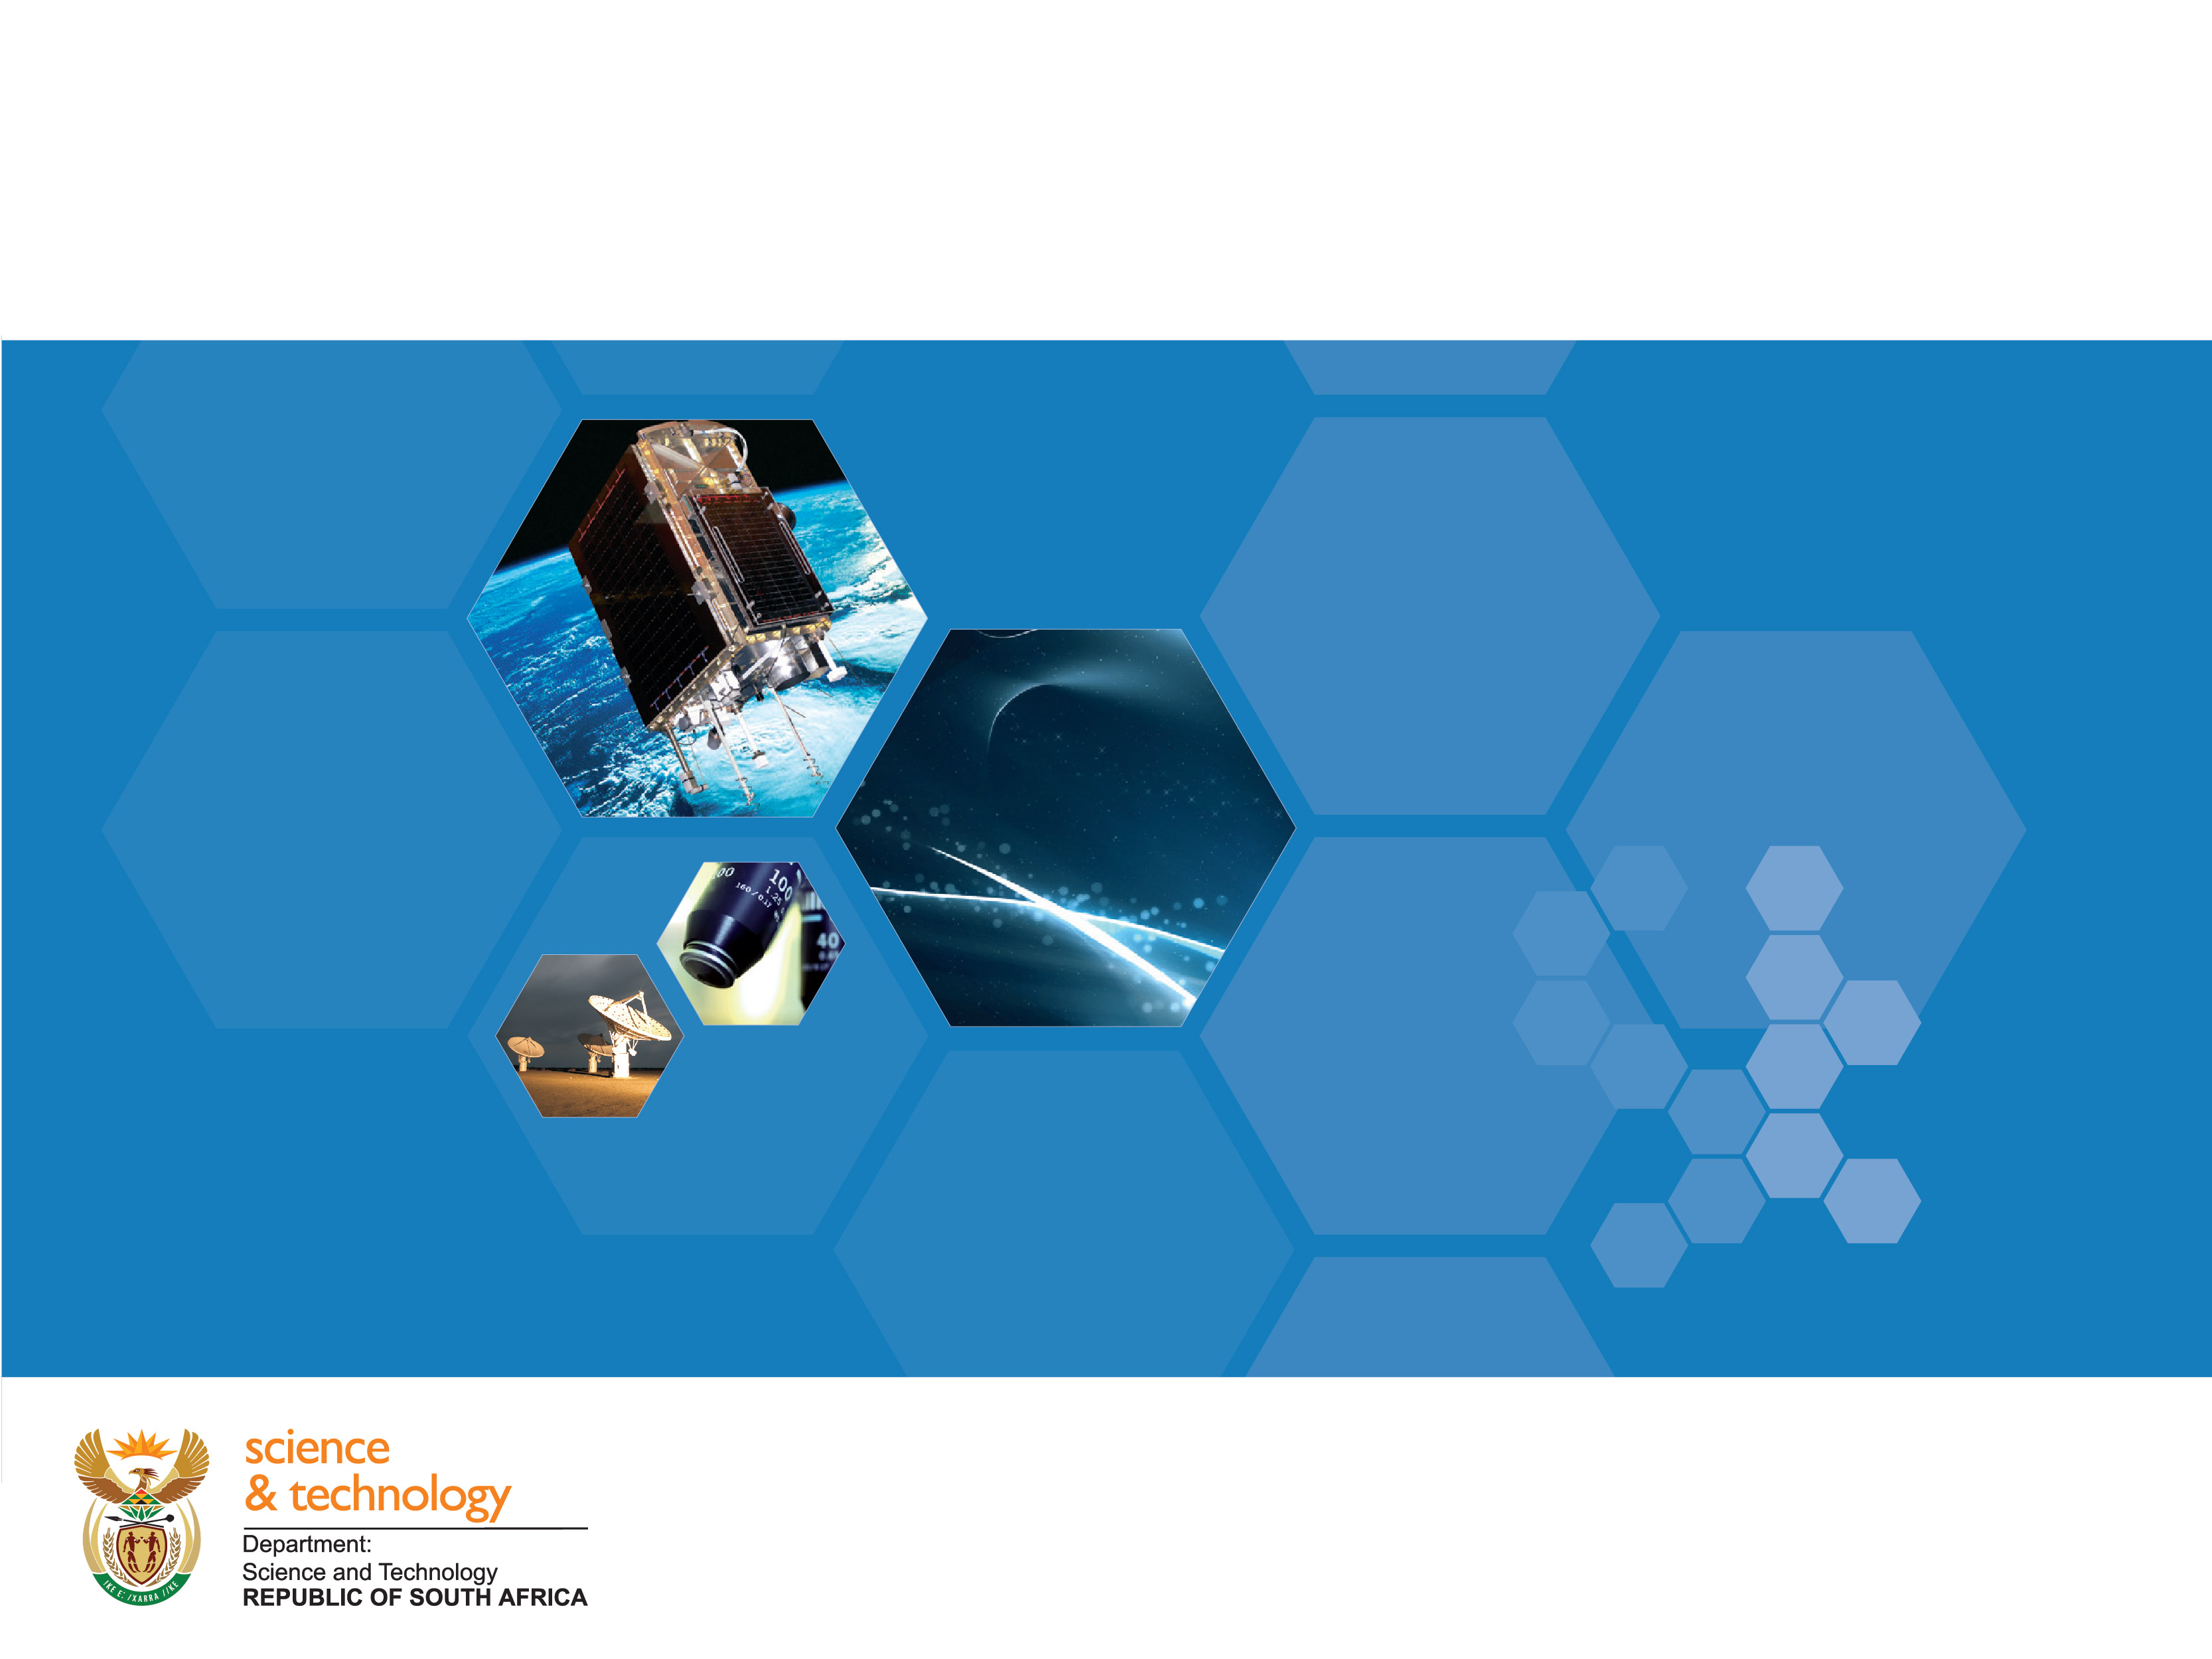
DST’s Policy & Plans for Data
Science
Takalani Nemaungani
AIMS Data Science Workshop
Cape Town
10 April 2018

Slide 2
Policy Framework
White Paper, 2002 National R&D Strategy, TYIP 2008/18
Ministerial approval of the Multi-wavelength Astronomy Strategy in 2015
Vision: South Africa as a global centre of research excellence for multi-wavelength Astronomy (SKA, SALT & Gamma-ray
Mission: Develop Astronomy as a means to stimulate frontier science, cutting-edge technology and human capacity development within South Africa and throughout the African continent
Key pillars: scientific excellence, HCD, Big Data and Instrumentation.
PICC SIP-16 project & prioritized in all SONAs(NDP)

Slide 3
Strategic Goals
A thriving ecosystem for Big Data in South Africa, covering the full spectrum of training, platform development, application development, business consultancy, research activities, funding for research and commercialization, supporting infrastructure, and international collaboration
Interventions aimed at developing a critical mass of expertise required to be a competitive global player in Big Data

Slide 4
Strategic Goals & Interventions
A thriving ecosystem for Big Data in South Africa, covering the full spectrum of training, platform development, application development, business consultancy, research activities, funding for research and commercialization, supporting infrastructure, and international collaboration
Interventions aimed at developing a critical mass of expertise required to be a competitive global player in Big Data

Slide 5
Strategic Goals & Interventions
To foster a culture of research, innovation and commercialization in Big Data initiatives with particular focus capacity building in the universities and on enabling an innovative culture of SMME support and development
Widespread and productive employment of data intensive applications in government, academia and business promoting better informed decision making, world class research outputs and economic benefits
Investments in high quality cyber infrastructure is in place to support commercial, academic and government Big Data initiatives

Slide 6
Srategic Goals & Interventions
There is pervasive use of big data analytics / smart decision making in a number of prominent governments programme areas: health, astronomy, security, green economy, smart cities, etc
Big Data is a firm part of the undergraduate and graduate level curriculum at most of the major universities and significant interacting research groups have been established at these, driving a healthy spin-off culture of innovation and new business development.

Slide 7
DST Enabling Initiatives
National Integrated CyberInfrastructure System (NICIS) and its main components:
Centre for High Performance Computing (CHPC), the South African Research Network (SANReN), TENET, the Very Large Database and Management Systems (VLDB) now Data Intensive Research Infrastructure (DIRISA and the SAGrid Initiative.
DIRISA born by the recognition that the need to manage very large data sets, goes beyond the physical storage requirements to issues such as curation, provenance, trust, digital preservation, and analysis techniques.

Slide 8

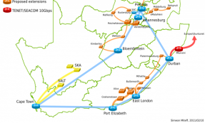


SA: National Integrated Cyber-infrastructure System (NICIS)
Amalgamated, physically distributed cyber platform for data intensive research
Overarching coordination & national strategy for Cyber-infrastructure
DIRISA: national and regional data stewardship
eResearch Skills development
SKA
Drivers of Big Data
Humans & Society
Environment
e-Agriculture
Energy
Bioinformatics
Health
NICIS
Computing Services (CHPC)
Networking Services (SANReN)
Data Services (DIRISA)
Skills & Expertise (HCD)
Cyberinfrastructure

Slide 9
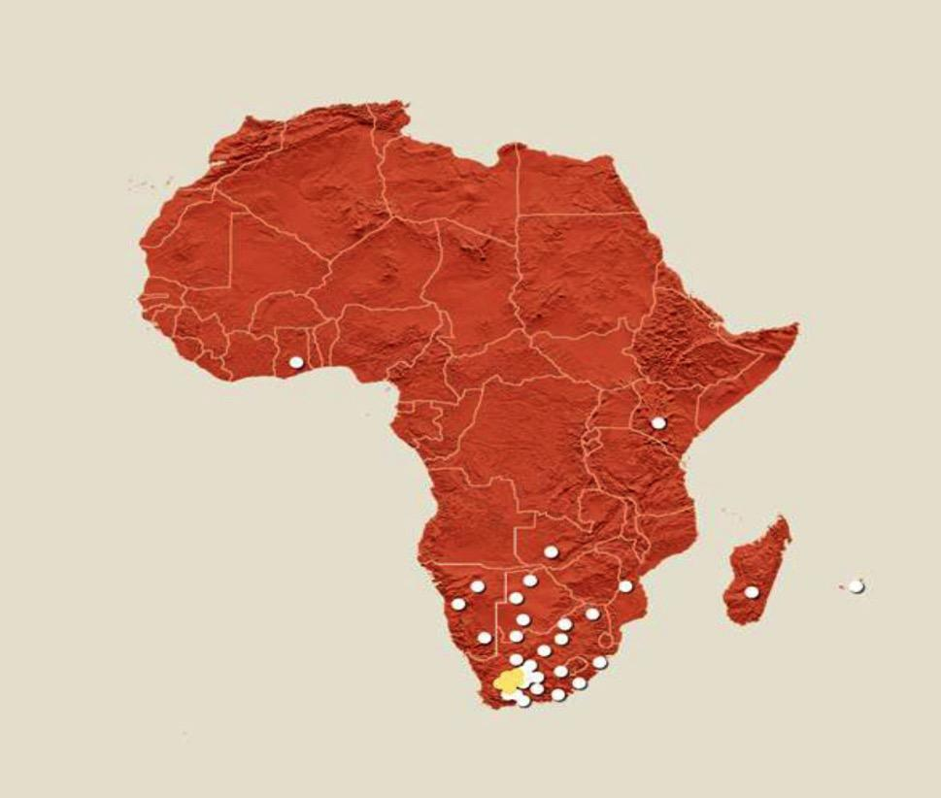
Big Data in Africa => Multi-disciplinary
Astronomy
Earth Observation
Bioinformatics
Particle Physics
Environmental Science
Health
Agriculture
Natural Resources
Social Science & Humanities
Multi-disciplinary
Materials Science
Education
Manufacturing
Smart Cities
Financial & Insurance
Government Services
Transportation
Retail
Security
Water Supply
Mining
Food Security
Renewables

Slide 10
Big Data Initiatives in South Africa
The establishment of a regional data centre to a consortium, led by UCT - a shared resource, focused initially on astronomy and bioinformatics
National e-Science Post-Graduate Teaching and Training Platform (NEPTTP) established and awarded to a consortium led by Wits University - key focus on offering a multi-disciplinary e-Science Master’s degree
Prof Russ Taylor, Research Chair on Big Data & Radio Astronomy at UCT/UWC
The newly established Sol Plaatjie University introduced a first dedicated undergraduate degree in data science
The Big Data Africa Programme - is aimed at building computing capabilities in partner countries to prepare them for AVN and SKA and to establish the African Research Cloud
Recent Upgrade of CHPC facilities to Petascale to meet the data demands of MeerKAT and SKA (Storage, African Cloud, etc)

Slide 11
Industry Involvement and Benefits
IBM Research Lab established in Johannesburg
CISCO-NMMU Centre for Broadband
Printed Circuit Boards (PCB) manufacturing facility revived
Max Planck Association investment of R170m - additional receivers on MeerKAT

Slide 12
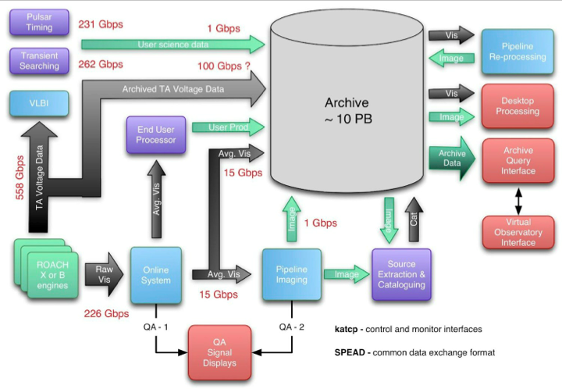
MeerKAT Data Processing

Slide 13
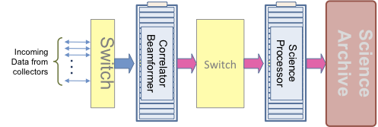
The Data Challenge
 | MeerKAT | SKA1-Mid | SKA2-Mid*
Into Correlator | 2 Tbps | 50 Tbps | up to 5 Pbps
Into Science Processor | 0.7 Tbps | 20 Tbps | up to 500 Tbps
Into Archive | 20 Gbps** | 300+ Gbps | up to 2 Tbps
Compute load | 200 TFlops | 30+ PFlops | 3+ EFlops
* Data rates indicative only
** Sustained

Slide 14
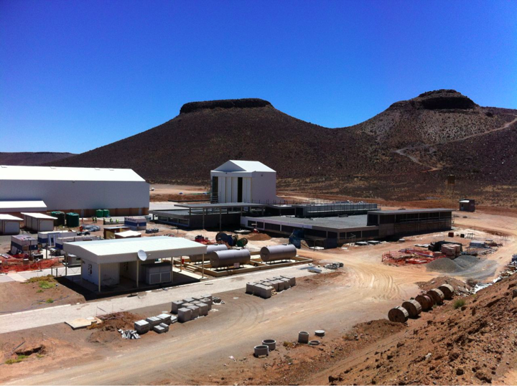
MeerKAT Site Complex

Slide 15
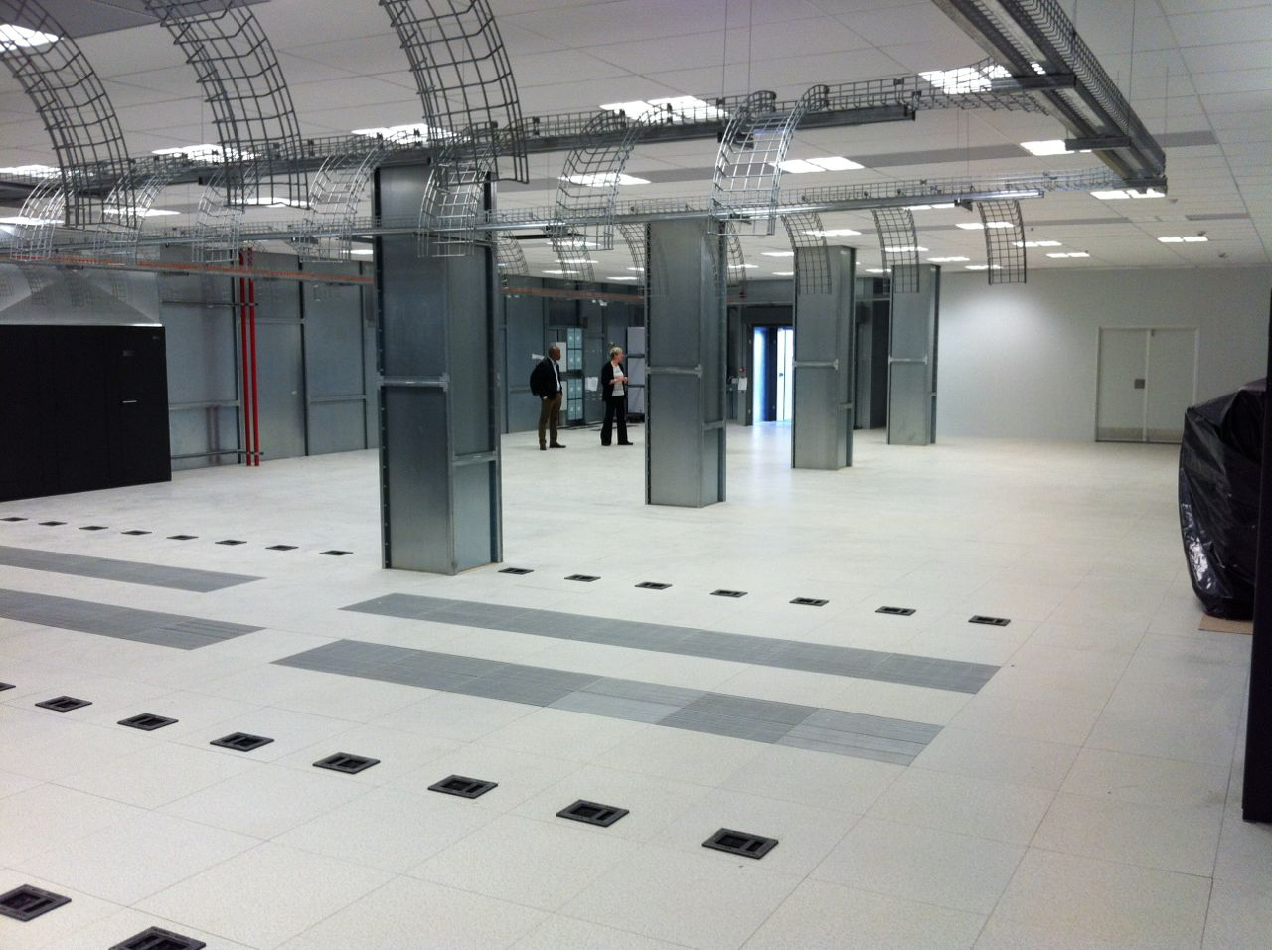
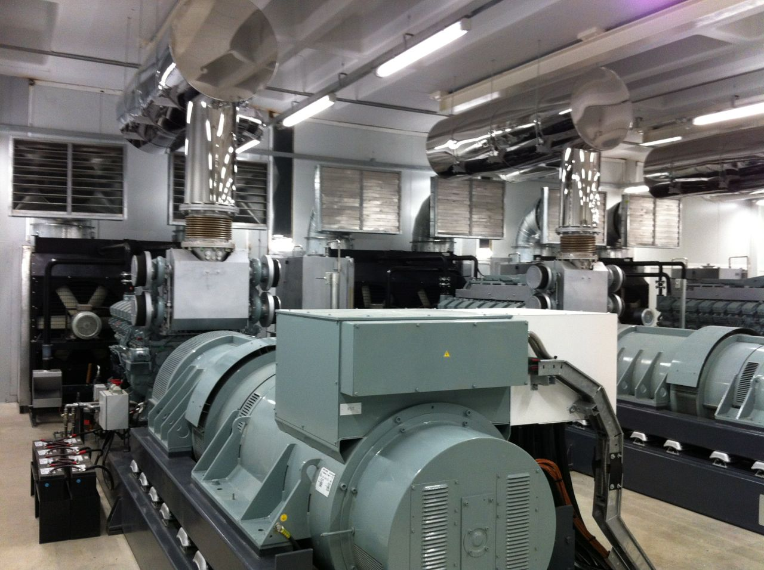
Karoo Array Processor Building

Slide 16
Big Data High Performance Computing Facility (BDHPC)
Proposed by the Western Cape Department of Economic Development and Tourism (DEDAT)
The main objective of the proposed Facility is to provide the required HPC and Data storage requirements to the SKA Project as well as to assist sectors within industry, government and academia to exploit the opportunities offered by advanced computing.
The proposed Facility is Modular for phased implementation. Facility phase one will be sufficient for SKA Phase One and the other stakeholders:
Compute - 96000 cores, 8000 GPU’s
Predicted Peak Performance - 9,8 PFlops
Power - 4,8 MW scalable to 9,6 MW
The primary goal of this feasibility study is to evaluate the risks and the potential that surround the establishment of a new supercomputing facility in the Western Cape, in collaboration with the CHPC.
Status:
Preliminary Feasibility Study completed by SKA SA: under final review
Critical Success Factor: SKA Organisation site decision for SDP

Slide 17
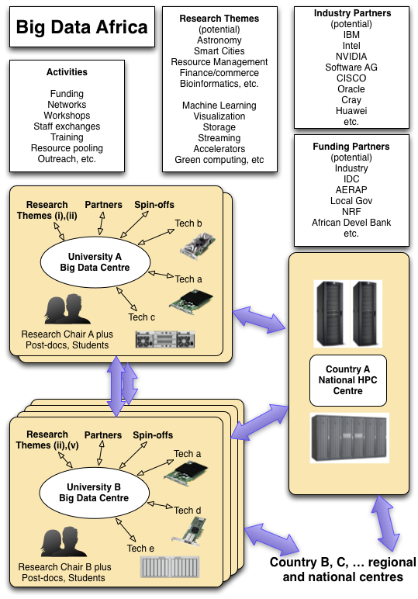
Big Data Africa

Slide 18
IDIA Campus
“Infrastructure for Data Intensive Applications”
Hardware, software, cyber-infra, proximity
a) Primary research; b) HPC facility and systems group; c) Manufacturing; d) Applications groups
Manufacturing includes packaging, cooling, 3D printing, PCB manufacture
Strong SMME and start-up focus
Gov funded initially, work towards self-sustaining commercial applications
“Silicon Valley” ecosystem, innovation, incubation, agile development, problem sharing, some admin support
Need to be bold here!

Slide 19
Key MeerKAT/SKA Success Stories
World class KAT-7 & MeerKAT telescopes designed and manufactured locally – already producing scientific results
Catalyst in the NSI through various Big Data initiatives
Contributed largely to tripling of number of astronomers from 60 to over 180 in 10-15 yrs and pipeline increasing…
SKA HCD Programme awarded 820 grants and scholarships - graduated over 56 PhDs and 117 Masters
Commercial spin-offs, localisation and innovations
Regional Development in partner countries (HCD, Institutional Capacities, Higher Education, Computing Skills)
Strengthened international partnerships and foreign investments (IBM, CISCO, Max Planck, etc)

Slide 20

THANK YOU
20

